Slide 1


EagleSat 2
Madison Fougere – Systems Team Lead
Embry-Riddle Aeronautical University Arizona Space Grant Consortium Symposium
April 3rd, 2020

Slide 2
Outline
Project Overview
Systems Team Purpose
Successes
Challenges
Current/Future Work

Slide 3
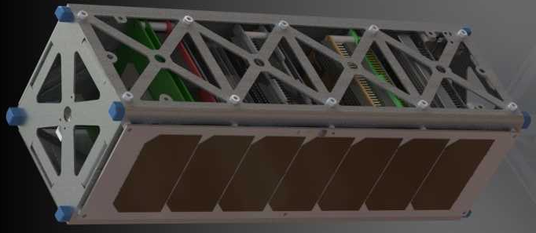
Project Overview
Scientific Goals
Memory degradation experiment (MDE)
Cosmic Ray Payload (CRP)
Spacecraft – 3U CubeSat

Slide 4
Systems Team Purpose
Education
Many young members of the team
Learn about systems engineering
System level integration
Work to bring different parts of the project together
Deliverable Documents
Safety documentation
Project Schedule
Testing and Verification Procedures

Slide 5
Successes
Dedicated team members
Good meeting attendance
Quality work
Strong desire to learn
Fall deliverables
Safety Documentation
Spring work
Flow charts
Block diagrams
Testing Procedures

Slide 6
Challenges
Completely new team
New members to EagleSat program
Steep Learning Curve
Young team
2 freshman
2 sophomores
Busy team
All team members are pursuing engineering degrees
3 members had to leave the team
Campus closures
Plague has severely limited lab access

Slide 7
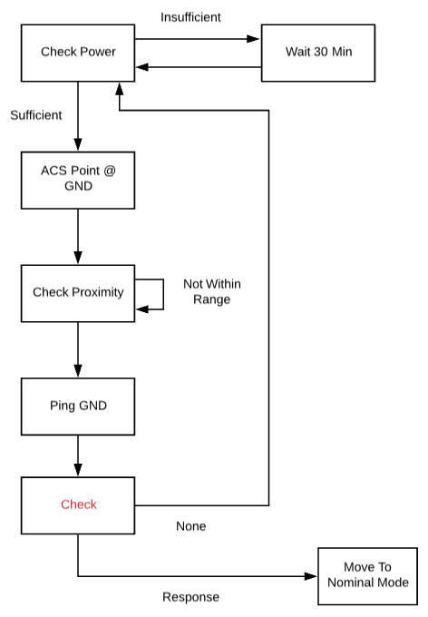
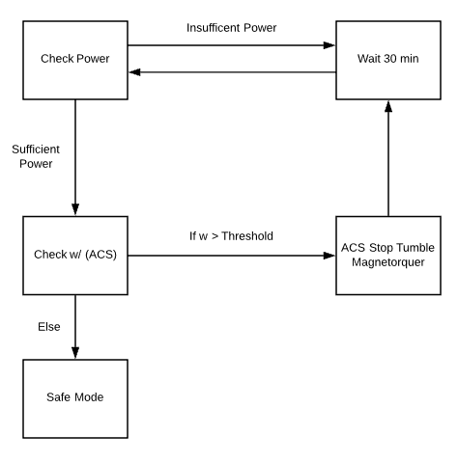
Current/Future Work
Block Diagrams of every system
Work with other teams to develop
For use by onboard computer team in software development
Safe mode block diagram
Detumble mode block diagram

Slide 8
Current/Future Work
Test Procedures
How each system needs to be tested
How tests are passed or failed
Validation/Verification
Ensure systems work as they were intended
Ensure system intentions were correct for mission
System Integration
Combine systems effectively to produce a proper Cube Satellite

Slide 9
Questions?

